Slide 1
Home-based Business Networking Event

Slide 2
Welcome
Home-based businesses are a significant part of our local Adelaide Hills economy. Forty per cent of businesses that responded to our recent Business Survey were home-based.
Adelaide Hills Council wants to reach out to home-based businesses to:
Provide information about business services available in the region,
Assist you to connect with other home-based businesses , and
Better understand the needs of local home-based businesses.
Brett Mayne
A/Manager Economic Development
ahc.sa.gov.au

Slide 4
Home-Based Business Information session
Adelaide Hills Council
Kirsty Parkin
Business and Industry Development Manager
Small Business Team

Slide 5
Department for Innovation and Skills (DIS)
Making a difference so South Australia thrives
Growing the South Australian economy by supporting people and business to succeed
We support economic growth by:
Helping people get the skills they want, and the skills the economy needs
Increasing South Australia’s productivity growth rate through research and innovation
Supporting entrepreneurs and business growth

Slide 6
SA Small Business landscape
Total SA population = 1.7M
@150k small businesses operating in SA
Represent @98% of all the
State’s businesses
Employ @40% of the SA
workforce
Contribute more than
$60 billion to sales and service
income in SA.

Slide 7
Business lifecycle

Slide 8
SA Business Hub
SA Business Infoline
Phone: (08) 8429 3801 (9am – 5pm Monday to Friday)
Email: DIS.SmallBusiness@sa.gov.au

Slide 9
Regional Support
South Australian Disaster Small Business Transformation & Growth Program
The SA Government continues to support the Adelaide Hills and Kangaroo Island communities following the devastating 2019/20 bushfires with a range of measures, including established Business Hubs, connecting businesses to information and support services to help successfully start, run and grow their business.
Adelaide Hills Business Hub
Located at the Adelaide Hills Business Centre at Woodside, you can book an appointment with Amanda Hunt, Business Recovery Officer – Adelaide Hills (Monday, Wednesday, Friday 9am – 5pm or by appointment).
Phone: Amanda Hunt on 0435 288 469 Email: Amanda.Hunt@sa.gov.au
Kangaroo Island Business Hub
Located on Commercial Street in Kingscote, the Hub offers a range of in-house services including business information, expert advice, government support services, coaching and mentoring, co-working and event spaces to help your business start, grow or become more competitive.
Phone: Susi Whitehead on 0429 005 356. Email: KIbusinesshub@sa.gov.au

Slide 10
Business Engagement Program
Supporting business growth and competitiveness
Tailored Case Management Services:
DIS works closely with businesses to help them build their capability and capacity to grow. This includes tailored case management services to connect businesses to the information, advice, resources, programs, other businesses and opportunities, to support their business growth and competitiveness.
In Partnership with Business and Industry:
DIS works closely in partnership with business and industry, and across the three tiers of government and other SA stakeholders, to ensure business and industry are provided access to the most up to date information and to inform the successful delivery of programs, initiatives, resources and support services.
Website: business.sa.gov.au
Phone: (08) 8429 3801 Email: DIS.SmallBusiness@sa.gov.au

Slide 11
Home-Based Business Information session
Adelaide Hills Council
Kirsty Parkin
Business and Industry Development Manager
Small Business Team

Slide 12
fibre initiative
Aligned with Federal Government initiatives, nbn™ continues to invest to accelerate economic growth and support regional
and metropolitan businesses.
Notes:
Nbn local -who are we what we do – Wholesaler - We build the highway – you choose the car you want to drive on it
BFI announced Sept last year – 8 BFZ in Regional SA – including Murray Bridge
Covid Effect - Cloud Based Services/Video Conferencing/Transfer of HD Images/Need for speed
We wanted to give Regional Businesses access to business Grade Fibre
The BFI is based around our Business Grade Fibre product which we call Enterprise Ethernet
Speed – 1000/1000 Symmetrical
Priority Data – Freeway scenario
Premium Service Levels – 24/7 support/Restoration Targest 4/6/8/12
Choice of RSP – 25 – competition fighting for your business
50 Business Day Build Time
No upfront Connection costs when connected to a 3 year plan
Home based Businesses – don’t need an abn
Prior to Sept last year anyone could connect to EE at their own cost – Subsidise cost – 90% of Australian Businesses – OUTSIDE OF BFZ -SHOW MAP
Saving of up to 68% - Fibre based businesses can still take adv of $0 build
Co-investment
Where to get assistance – my details
QUESTIONS

Slide 13
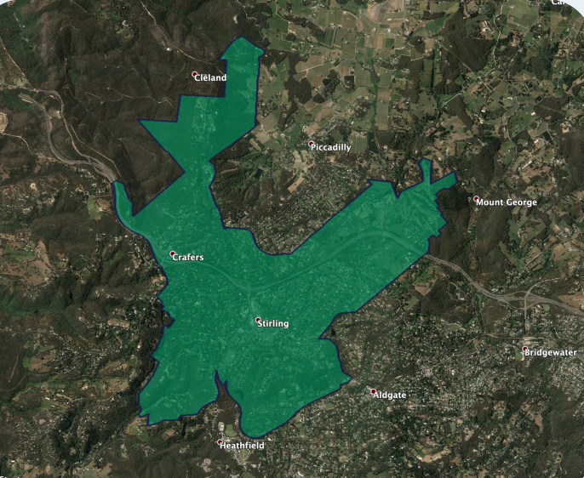
fibre initiative
Stirling is a business nbn™ fibre zone
295 zones estimated to cover more than 295,000 business locations across regional areas nationally
business nbn™ fibre zones have been identified based on the density in an area of business premises with high connectivity needs.
Around 530 businesses should now be able to access the benefits.
Notes:
Nbn local -who are we what we do – Wholesaler - We build the highway – you choose the car you want to drive on it
BFI announced Sept last year – 8 BFZ in Regional SA – including Murray Bridge
Covid Effect - Cloud Based Services/Video Conferencing/Transfer of HD Images/Need for speed
We wanted to give Regional Businesses access to business Grade Fibre
The BFI is based around our Business Grade Fibre product which we call Enterprise Ethernet
Speed – 1000/1000 Symmetrical
Priority Data – Freeway scenario
Premium Service Levels – 24/7 support/Restoration Targest 4/6/8/12
Choice of RSP – 25 – competition fighting for your business
50 Business Day Build Time
No upfront Connection costs when connected to a 3 year plan
Home based Businesses – don’t need an abn
Prior to Sept last year anyone could connect to EE at their own cost – Subsidise cost – 90% of Australian Businesses – OUTSIDE OF BFZ -SHOW MAP
Saving of up to 68% - Fibre based businesses can still take adv of $0 build
Co-investment
Where to get assistance – my details
QUESTIONS

Slide 14
Next Steps
Learn more
Rachel Leonow
Regional Business Lead SA/NT
Email: rachelleonow@nbnco.com.au
Mob: 0419 603 677
Learn more about the business nbn™ fibre initiative, Enterprise
Ethernet and check your eligibility –
nbnco.com.au/businessfibre
Notes:
Nbn local -who are we what we do – Wholesaler - We build the highway – you choose the car you want to drive on it
BFI announced Sept last year – 8 BFZ in Regional SA – including Murray Bridge
Covid Effect - Cloud Based Services/Video Conferencing/Transfer of HD Images/Need for speed
We wanted to give Regional Businesses access to business Grade Fibre
The BFI is based around our Business Grade Fibre product which we call Enterprise Ethernet
Speed – 1000/1000 Symmetrical
Priority Data – Freeway scenario
Premium Service Levels – 24/7 support/Restoration Targest 4/6/8/12
Choice of RSP – 25 – competition fighting for your business
50 Business Day Build Time
No upfront Connection costs when connected to a 3 year plan
Home based Businesses – don’t need an abn
Prior to Sept last year anyone could connect to EE at their own cost – Subsidise cost – 90% of Australian Businesses – OUTSIDE OF BFZ -SHOW MAP
Saving of up to 68% - Fibre based businesses can still take adv of $0 build
Co-investment
Where to get assistance – my details
QUESTIONS

Slide 15
Strong, Confident and Vibrant Regions
Steve Shotton
Regional Development Manager

Slide 16
Regional Development Australia
…… is a national network of 52 Committees made up of local leaders who work with all levels of government, business and community groups to support the economic development of their regions.
Notes:
Economic development + Livability

Slide 17
RDA Role
Advise on critical issues affecting economic development
eg; SE Freeway Congestion, Freight routes, Housing
Identify opportunities to drive economic development
eg: Mt Barker wastewater re-use, Regional University Centres
Assist project proposals and facilitate access to private and public funding
eg: Premix Concrete Plant, Strathalbyn Abattoir
Promote government policy and programs
eg: Building Better Regions Fund, Regional Growth Fund, TIDF

Slide 18
Services
Project advice and support
Economic Impact Modelling
Feasibility studies
Project Advocacy with all levels of govt
Connections and collaborations
Access to capital (private and public)
Desktop research

Slide 19
Resources
Hills & Coast Grant Finder
https://rdahc.grantguru.com.au/
Economic and Community datasets
https://economy.id.com.au/rda-ahfki
RDA Weekly Newsletter
https://rdahc.com.au/

Slide 20
Thank You
Steve Shotton
Regional Development Manager
M: 0407 713 239 E: stephens@rdahc.com.au

Slide 21
New Planning and Design Code
James Szabo
Senior Strategic and Policy Planner

Slide 22
Do I need approval?
Most of the time: NO
Sometimes: YES
ahc.sa.gov.au

Slide 23
Most of the time: NO
Provided it's small scale, and
Meets the definition of “Home Activity”
ahc.sa.gov.au

Slide 24
PDI (General) Regulations 2017 Part 1 Clause 3
What is a “Home Activity”
Def. “A use of a site by a person resident on the site:
PDI (General) Regulations 2017 Schedule 5 Clause 5
2
QUANTITATIVE
1
QUALITATIVE
That does not detrimentally affect the amenity of the locality or any part of the locality*
That does not require assistance by more than one person who is not a resident in the dwelling;
That does not exceed 30sqm of floor area
That does not cause the imposition on services
That does not display any goods
That does not involve the use of a vehicle exceeding three tonne tare
ahc.sa.gov.au

Slide 25
Home Activity
If your business can operate within the Home Activity definition thresholds, you're all good - no planning application is required!
However…
ahc.sa.gov.au

Slide 26
Home Activity cont…
*If Council at any time throughout your business operation receives a legitimate complaint you might have an issue, as it may pull in to question the amenity clause.
ahc.sa.gov.au

Slide 27
Sometimes: YES
If it is determined that an existing business is having a detrimental impact on the amenity of the locality
If it exceeds the Home Activity definition thresholds
ahc.sa.gov.au

Slide 28
Seeking Planning Approval
Seek advice from Council or a Planning Consultant to define what your business is and begin to prepare mandatory documentation
1
2
Lodge application and pay processing fees via Plan SA Portal
Liaise with Council throughout the process and await decision (allow five weeks minimum)
3
ahc.sa.gov.au

Slide 29
Are you guaranteed approval?
No
An application for a non-residential use in a residential area is Performance Assessed. This means that every application is assessed on its merits with regard to its unique context.
ahc.sa.gov.au

Slide 30
My advice
Consider the risks and limitations of the Home Activity definition when planning for your business
1
Consider all options before lodging a planning application to formalise a home-based business use
2
ahc.sa.gov.au

Slide 31
Other considerations
1
Activities Involving Food
If you intend to establish a business that involves the preparation, transportation or storage of food for sale, you will be required to seek separate approval from Council’s Environmental Heath Officers, who will ensure compliance with the Food Act 2001.
2
Signage
The erection of signage is allowable if:
Signs are not illuminated, nor exceed 0.2sqm, and display only the name, address and identification of the business or profession; and
No nuisance shall be caused to any owner or occupier of land in the vicinity of your “Home Activity” as a result of the sign.

Slide 32
Thank you
ahc.sa.gov.au

